Slide 1

ILP 2023 – W2S3 While/Break statements
Matthieu DE MARI – Singapore University of Technology and Design

Slide 2
Outline (Week2, Session3 – W2S3)
While statements
Infinite loops and how to kill them
The break statement
(If time allows, recursion!)

Slide 3
The while statement
The while statement is another type of conditional structure.

Slide 4
The while statement
The while statement is another type of conditional structure.
The if statement is the simplest conditional structure.
How it works:
If the Boolean condition specified for the if statement is True, then execute the block of code inside the if statement.
If the Boolean condition is False, ignore the block of code in the if statement.
Once we are done executing the code in if (or ignoring it), move on to the next (non-indented) line.

Slide 5
The while statement
The while statement is another type of conditional structure.
How it works:
If the Boolean condition specified for the while statement is True, then execute the block of code inside the while statement.
If the Boolean condition is False, ignore the block of code in the while statement.
The if statement is the simplest conditional structure.
How it works:
If the Boolean condition specified for the if statement is True, then execute the block of code inside the if statement.
If the Boolean condition is False, ignore the block of code in the if statement.
Once we are done executing the code in if (or ignoring it), move on to the next (non-indented) line.

Slide 6
The while statement
The while statement is another type of conditional structure.
How it works:
If the Boolean condition specified for the while statement is True, then execute the block of code inside the while statement.
If the Boolean condition is False, ignore the block of code in the while statement.
Once we are done executing the code in while, move back to the while statement, and repeat until the condition is no longer True.
The if statement is the simplest conditional structure.
How it works:
If the Boolean condition specified for the if statement is True, then execute the block of code inside the if statement.
If the Boolean condition is False, ignore the block of code in the if statement.
Once we are done executing the code in if (or ignoring it), move on to the next (non-indented) line.

Slide 7
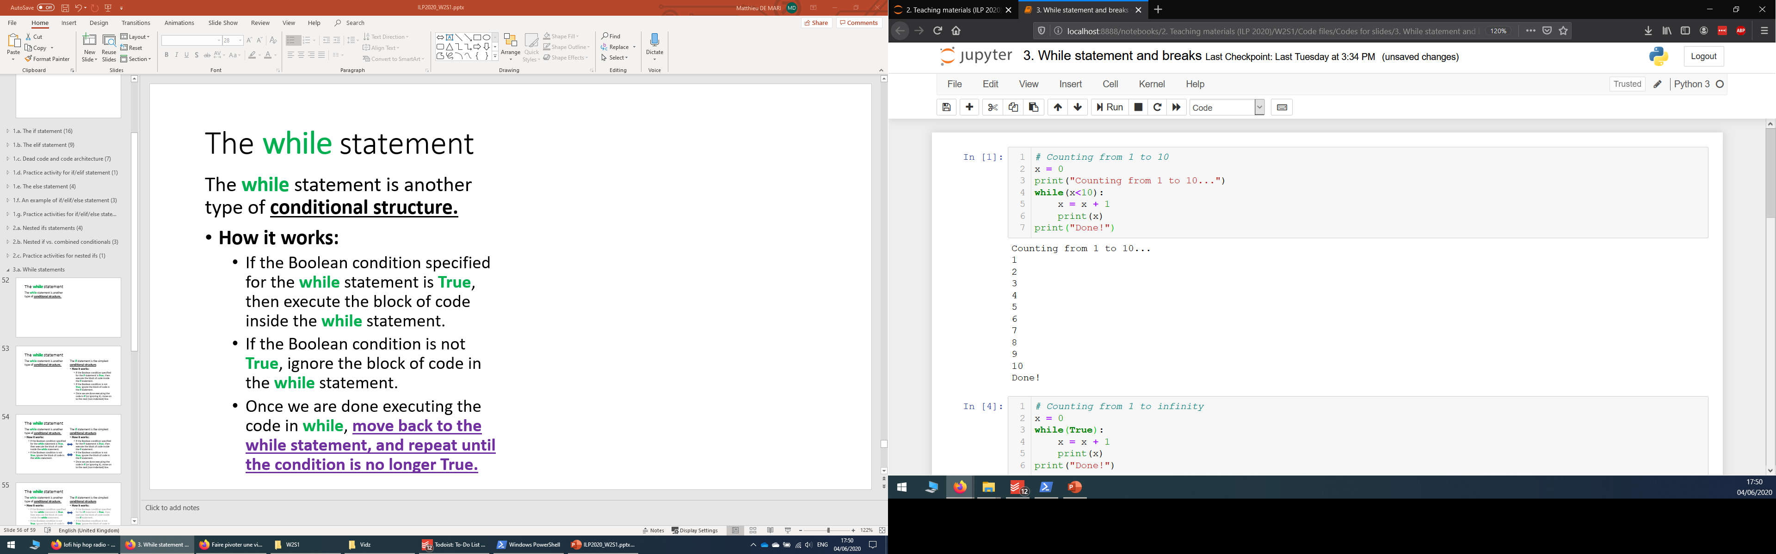
The while statement
The while statement is another type of conditional structure.
How it works:
If the Boolean condition specified for the while statement is True, then execute the block of code inside the while statement.
If the Boolean condition is False, ignore the block of code in the while statement.
Once we are done executing the code in while, move back to the while statement, and repeat until the condition is no longer True.

Slide 8
Architectures: if vs. while
Is condition in the while statement True?
Yes
No
Execute the code inside of the while block
Move on to the next non-indented line of code
Is condition in the if statement True?
Yes
No
Execute the code inside of the if block
Move on to the next non-indented line of code

Slide 9
Infinite loops
The while statement repeats a condition until it is no longer True.

Slide 10
Infinite loops
The while statement repeats a condition until it is no longer True.
This means that there should be a clear process that makes your condition no longer True, at some point.

Slide 11
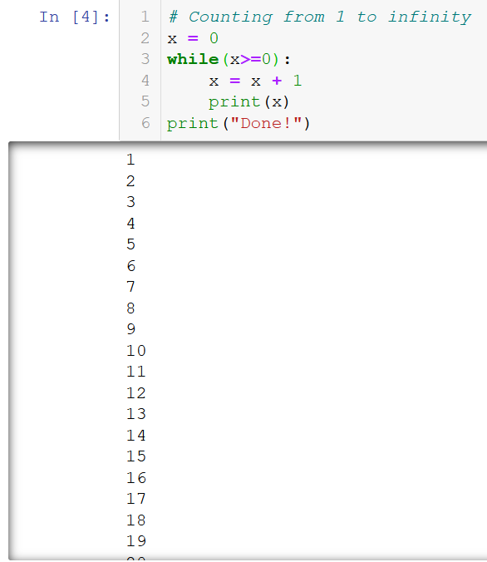
Infinite loops
The while statement repeats a condition until it is no longer True.
This means that there should be a clear process that makes your condition no longer True, at some point.
Otherwise, the while block will keep on repeating indefinitely… This is called an infinite loop.

Slide 12
Infinite loops and how to kill them
Infinite loops will keep on executing forever, unless
Your computer runs out of resources and performs an emergency shutdown before exploding (bad thing to do),

Slide 13
Infinite loops and how to kill them
Infinite loops will keep on executing forever, unless
Your computer runs out of resources and performs an emergency shutdown before exploding (bad thing to do),

Slide 14
Infinite loops and how to kill them
Infinite loops will keep on executing forever, unless
You decide to crash the program on purpose and kill the loop manually.

Slide 15
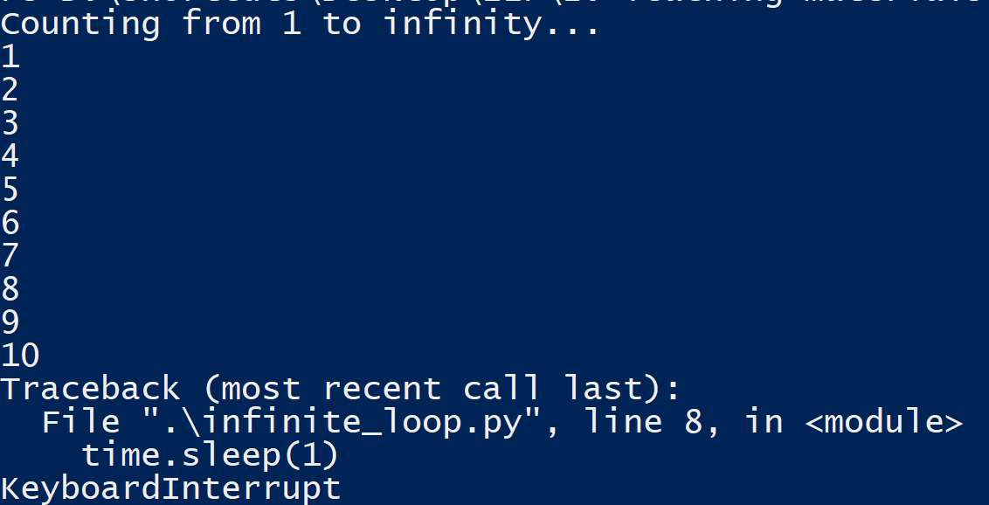
Infinite loops and how to kill them
Infinite loops will keep on executing forever, unless
You decide to crash the program on purpose and kill the loop manually.
This is called a keyboard interrupt. It is done with CTRL+C (or CMD+C on mac), in console mode and most IDEs.

Slide 16
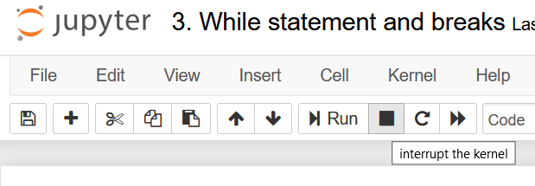
Infinite loops and how to kill them
Infinite loops will keep on executing forever, unless
You decide to crash the program on purpose and kill the loop manually.
This is called a keyboard interrupt. It is done with CTRL+C (or CMD+C on mac), in console mode and most IDEs.
Or, by using the stop button on Jupyter.

Slide 17


Infinite loops and how to kill them
Infinite loops will keep on executing forever, unless
You decide to crash the program on purpose and kill the loop manually.
This is called a keyboard interrupt. It is done with CTRL+C (or CMD+C on mac), in console mode and most IDEs.
Or, by using the stop button on Jupyter.
KEYBOARD INTERRUPT

Slide 18

Matt’s Great advice #7
Matt’s Great Advice #7: Avoid the infinite loops and dead code, by drawing structural diagrams.
Infinite loops and dead code, unless created on purpose, usually follow from a poor design in your code.
Drawing a structural diagram, before coding, greatly helps figuring out the right structure for your code.

Slide 19
Matt’s Great advice #7
Is the value of x greater than 10?
Yes
No
print(x) and increment x by one
print(“Done.”)
Initialize x as 0
Matt’s Great Advice #7: Avoid the infinite loops and dead code, by drawing structural diagrams.
Infinite loops and dead code, unless created on purpose, usually follow from a poor design in your code.
Drawing a structural diagram, before coding, greatly helps figuring out the right structure for your code.
Example: diagram for our while loop, counting from 1 to 10.

Slide 20
Infinite loops and how to kill them
Infinite loops will keep on executing forever, unless
You decide to crash the program on purpose and kill the loop manually.

Slide 21
Infinite loops: the break statement
Infinite loops will keep on executing forever, unless
You use a break statement.

Slide 22
Infinite loops: the break statement
Infinite loops will keep on executing forever, unless
You use a break statement.
When encountered, the break statement will immediately end the current while loop.
The code then resumes its execution with the next line outside of the while block.

Slide 23
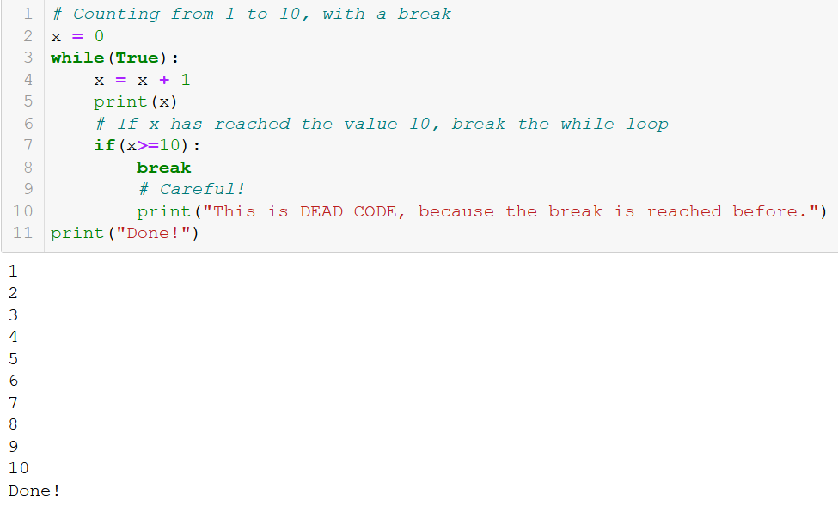
Infinite loops: the break statement
Infinite loops will keep on executing forever, unless
You use a break statement.
When encountered, the break statement will immediately end the current while loop.
The code then resumes its execution with the next line outside of the while block.

Slide 24
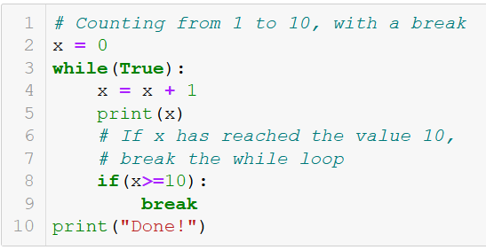
Standard while vs. infinite while + break
Standard while loop with condition in the while statement.
Infinite while loop with condition in an if statement, and break in the if block.
→ Both loops work and do the job, which one is better though?

Slide 25
Matt’s Great advice #8
Matt’s Great Advice #8: Avoid the infinite loops, if possible.
Relying on an infinite while loop with a break is risky, and should be avoided when possible.

Slide 26
Matt’s Great advice #8
Matt’s Great Advice #8: Avoid the infinite loops, if possible.
Relying on an infinite while loop with a break is risky, and should be avoided when possible.
It is often easily avoided, by using the Boolean expression of the if statement used for break, as the condition in the while statement.

Slide 27
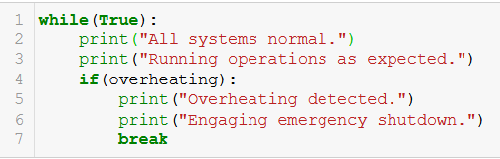
Matt’s Great advice #8
Matt’s Great Advice #8: Avoid the infinite loops, if possible.
Relying on an infinite while loop with a break is risky, and should be avoided when possible.
It is often easily avoided, by using the Boolean expression of the if statement used for break, as the condition in the while statement.
Note: a few cases, however, require the use of a break statement. For instance, emergency shutdowns.

Slide 28
Practice activities for while/break
Let us practice the while/break concepts a bit, with three activities.

Slide 29
Conclusion
While statements
Infinite loops and how to kill them
The break statement
(If time allows, recursion!)

Slide 30
Up for a challenge? (in the Extra challenges folder)
Challenge: Activity 1+ - How many hits can you take (extra challenge).ipynb
Similarly, as in other challenges…
Do not use any conditional statement (if/while)
Hint: use a bit of maths on sequences!

